Slide 1
What is the happiest generation?
Amy Williams
Capstone 1
7/24/2021

Slide 2

Background and Motivation
There are 6 main generations in the world today:
Generation Z: 1997-2012
Millenials (Generation Y): 1981-1996
Generation X: 1965-1980
Baby Boomers: 1946-1964
Silent Generation: 1928-1945
G.I. Generation: 1901-1927
Which is the Happiest?

Slide 3


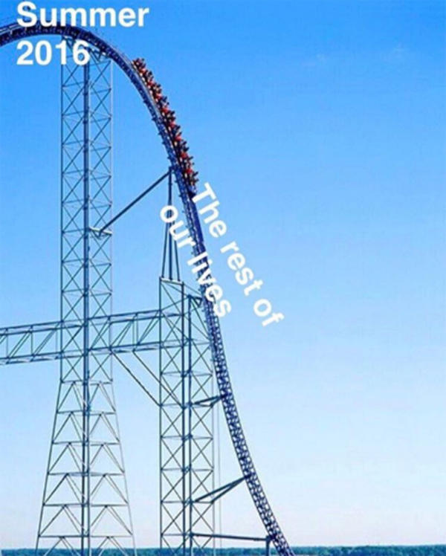
The Data
1985-2016
Not very much data provided for 2016
https://www.kaggle.com/russellyates88/suicide-rates-overview-1985-to-2016

Slide 4
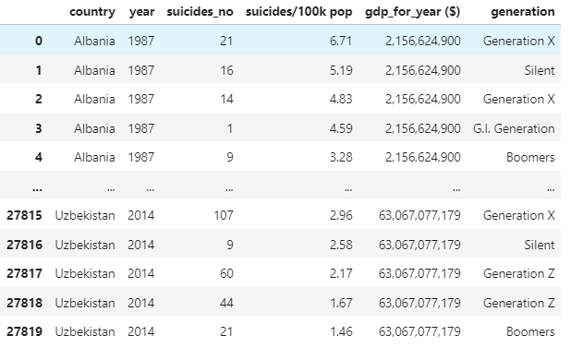
**This is only a preview of the data.

Slide 5
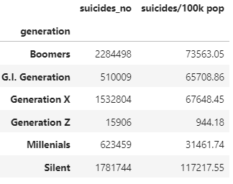
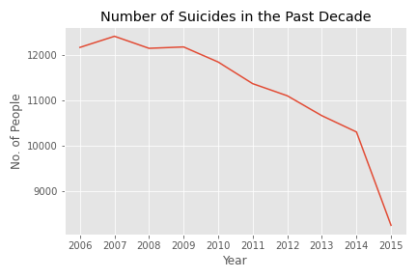
Explotatory Data Analysis)

Slide 6
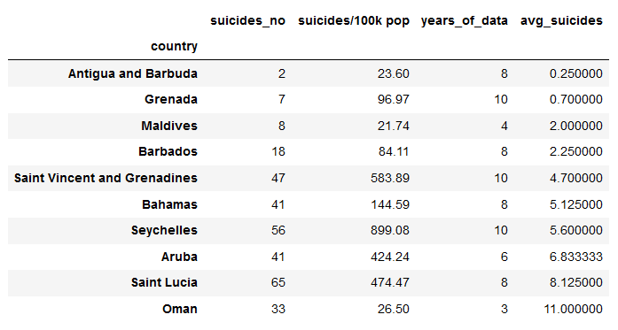
Top 10 Happiest Countries

Slide 7
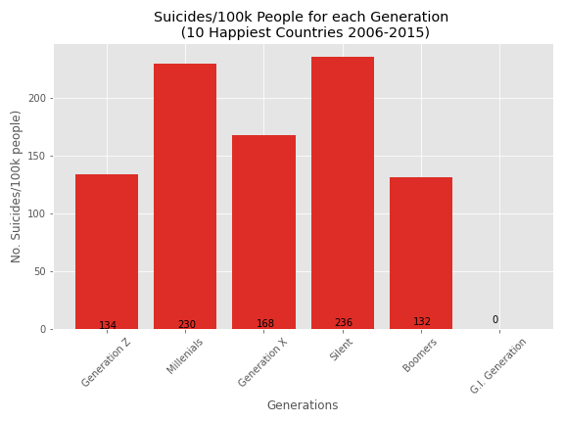

Slide 8
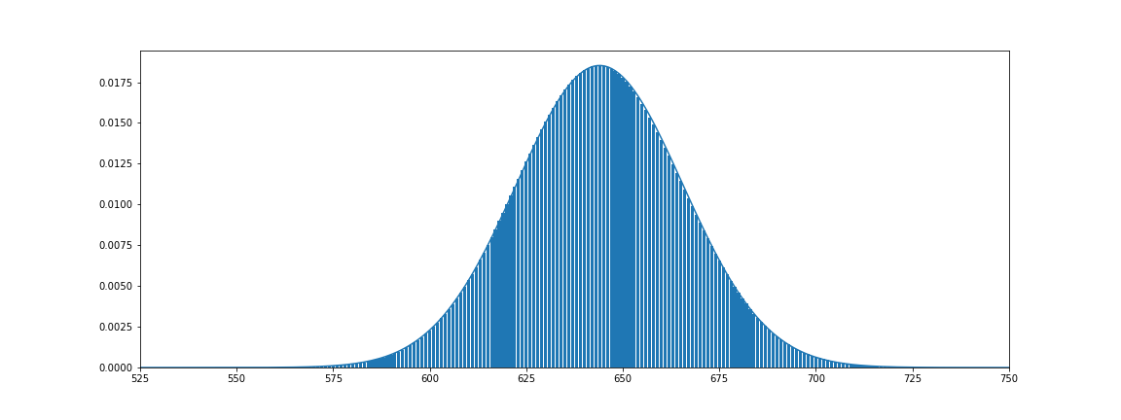
Statistical Analysis
With the information that I had, I decided to conduct a hypothesis test. In the entire 10 year span for the countries provided in the data set, there were 2,300,872 suicide deaths. This averaged to about 230,087 deaths per year. 636,436 of the total count were Boomers alone (making our mu about .28). For simplification purposes I divided all my values by 1000.
I want to find the probaility that a suicide death in this time span was commited by a Boomer, where my null hypothesis is that a randomlu elected suicide death in the deacade will not be a Boomer more than 28% of the time. Boomer Suicide≈𝐵𝑖𝑛𝑜𝑚𝑖𝑎𝑙(636,0.28)
My alpha is 0.05. (success = the individual is a Boomer, failure = individual is not a Boomer)
Success = Boomer
Failure = Not Boomer
Mu = 0.28
Alpha = 0.05

Slide 9
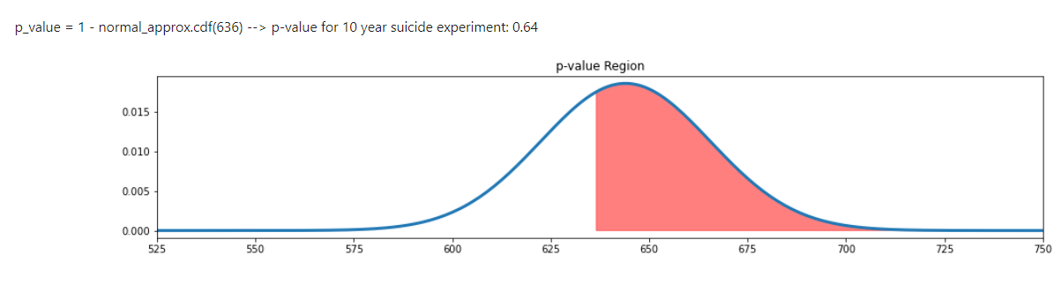
In conclusion...
Statistical Analysis (continued)

Slide 10
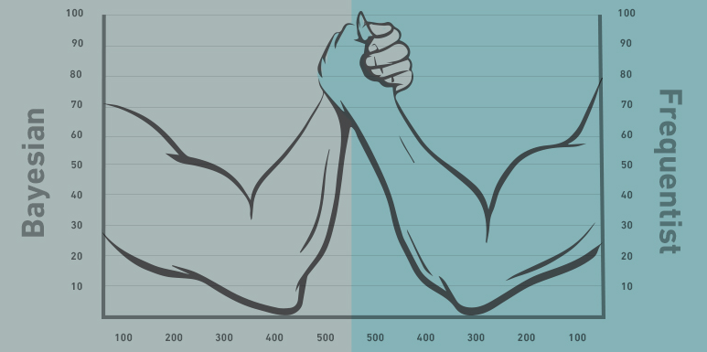

Future steps:
COmplete data set.
Fill missing Data
Find correlation with GDP
Compare global suicide rates to death rates
Bayesian testing

